Slide 1
MODULE 3: Radio Access Technologies in 5G
M3 S6
Beamforming Types

Slide 2
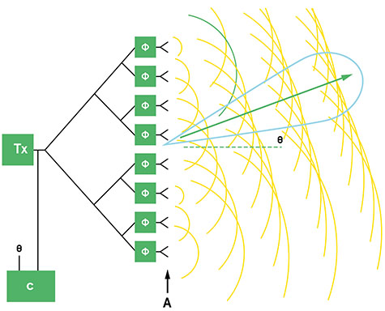
Beamforming Types
Working Principle
Beamforming is used with phased array antennae systems to focus the wireless signal in a chosen direction, normally towards a specific receiving device.
This results in an improved signal at the user equipment (UE), and also less interference between the signals of individual UE.

Slide 3
Beamforming Types
Working Principle
Phased antenna arrays are designed so that the radiation patterns from each individual element combine constructively, with those from neighbouring elements forming an effective radiation pattern - the main lobe - which transmits energy in the desired direction.
At the same time, the antenna array is designed so that signals sent in undesired directions destructively interfere with each other, forming nulls and side lobes.

Slide 4
Beamforming Types
Working Principle
The overall antenna array system is designed to maximize the energy radiated in the main lobe, whilst limiting the energy in the side lobes to an acceptable level.
The direction of the main lobe, or beam, is controlled by manipulating the radio signals applied to each of the individual antenna elements in the array.

Slide 5
Beamforming Types
Working Principle
Each antenna is fed with the same transmitted signal but the phase and amplitude of the signal fed to each element is adjusted, steering the beam in the desired direction.
Fast steering of the beam is achievable since the phase and amplitude of each signal are controlled electronically, allowing adjustments to be made in nanoseconds

Slide 6
Beamforming Types
There are three methods of implementing antenna beamforming:
Analogue beamforming
Digital beamforming
Hybrid beamforming

Slide 7
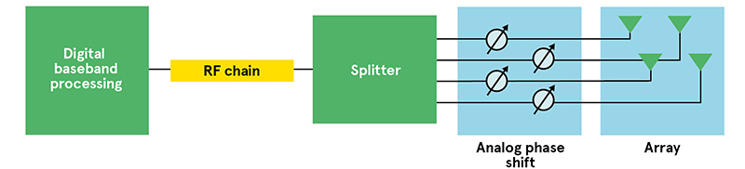
Beamforming Types
There are three methods of implementing antenna beamforming:
Analogue beamforming
Analogue beamforming is the simplest method, with the signal phase being changed in the analogue domain.
The output from a single RF transceiver is split into a number of paths, corresponding to the number of antenna elements in the array.
Each signal path then passes through a phase shifter and is amplified before reaching the antenna element.

Slide 8
Beamforming Types
There are three methods of implementing antenna beamforming:
Analogue beamforming
This is the most cost-effective way of implementing beamforming, since it uses a minimal amount of hardware, however an analogue beamforming system can only handle one data stream and generate one signal beam, limiting its effectiveness in 5G, where multiple beams are required.

Slide 9
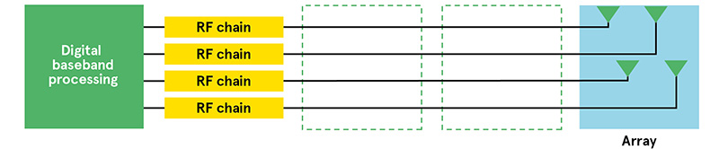
Beamforming Types
There are three methods of implementing antenna beamforming:
2. Digital beamforming
In digital beamforming, each antenna element is fed by its own transceiver and data converters (see Figure below), and each signal is pre-coded (with amplitude and phase modifications) in baseband processing before RF transmission.

Slide 10
Beamforming Types
There are three methods of implementing antenna beamforming:
2. Digital beamforming
Digital beamforming enables several sets of signals to be generated and superimposed onto the antenna array elements, enabling a single antenna array to serve multiple beams, and hence multiple users.
Although this flexibility is ideal for 5G networks, digital beamforming requires more hardware and signal processing, leading to increased power consumption, particularly at mm Wave frequencies, where several hundred antenna elements are possible..

Slide 11
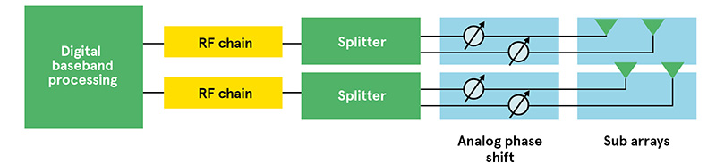
Beamforming Types
There are three methods of implementing antenna beamforming:
3. Hybrid beamforming
Hybrid beamforming (see Figure below) - where analogue beamforming is carried out in the RF stage, and digital beamforming in the baseband - offers a compromise between the flexibility of digital beamforming and the lower cost and power consumption of analogue...

Slide 12
Beamforming Types
There are three methods of implementing antenna beamforming:
3. Hybrid beamforming
Hybrid beamforming is recognised as a cost-effective solution for large-scale, mmWave antenna arrays and various architectures are being developed for gNB, (5G base station) implementations.
These architectures divide broadly into fully connected, where each RF chain is connected to all antennas; and sub-connected or partially connected, in which each RF chain is connected to a set of antenna elements.....

Slide 13
Beamforming Types
There are three methods of implementing antenna beamforming:
3. Hybrid beamforming
Each architecture aims to reduce the hardware and signal processing complexity, while providing near optimal performance: the closest to that of pure digital beamforming.....

Slide 14
!!THANK YOU!! !! Have a Nice Day!!
Today we learned about Beamforming Types

Slide 15
MODULE 3: Radio Access Technologies in 5G
M3 S7 , S8 & S9
Small Cells in 5G
HetNets in 5G
Millimeter wave Communication

Slide 16

Small Cells in 5G
What Is Small Cell Technology?
Small cells use low-power, short-range wireless transmission systems (or base stations).
They cover small geographical areas or small-proximity indoor and outdoor spaces.
Small cells have the same characteristics as base stations used by telecom companies for years.

Slide 17
Small Cells in 5G
What Is Small Cell Technology?
Small cell can handle high data rates for mobile broadband and consumers, as well as high densities of low-speed, low-power devices for IoT.
These capabilities make them pivotal for 5G cell planning to deliver:
Ultrahigh speeds
One million devices per square mile
Latencies in the millisecond range

Slide 18
Small Cells in 5G
How Small Cell Transceivers Work?
Small cells improve leveraging of multiple-input, multiple-output (MIMO), beamforming and millimeter wave (mmWave).
This concept simplifies transmission station deployment and speeds implementation.
In addition, these transceivers can mount to the wall for indoor applications.
For outdoor coverage, small towers and lamp posts are used.
Backhaul connections are less complicated than before and are usually made of fiber, wired or microwave connections.

Slide 19
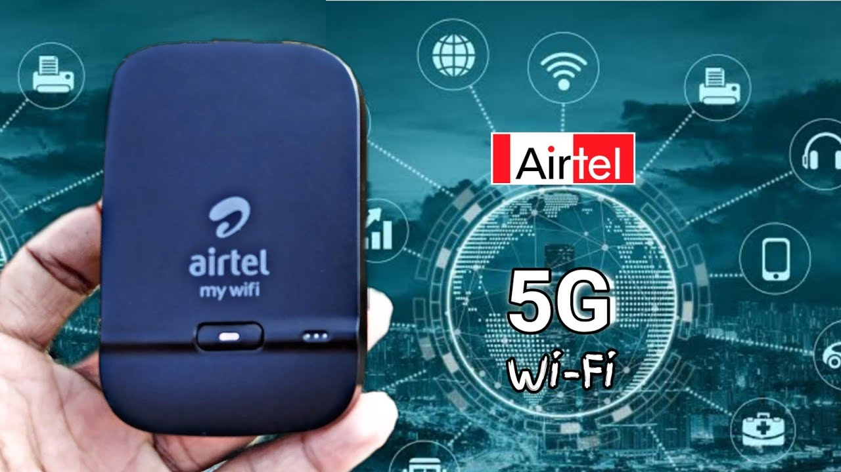
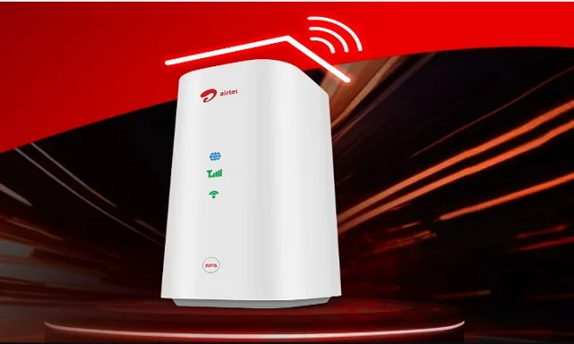
Small Cells in 5G
How Small Cell Transceivers Work?
In 3GPP Release (Rel) 17 and 18, there is also a concept of integrated access and backhaul for mmWave technology.
Instead of fiber or other means, ultrahigh-speed mmWave signals connect cell sites’ backhaul directly over a cellular connection.
It requires line of sight between the sites but saves capital and operating expenses because no new fiber needs to be installed.
Airtel Xstream AirFiber 5G wireless service

Slide 20
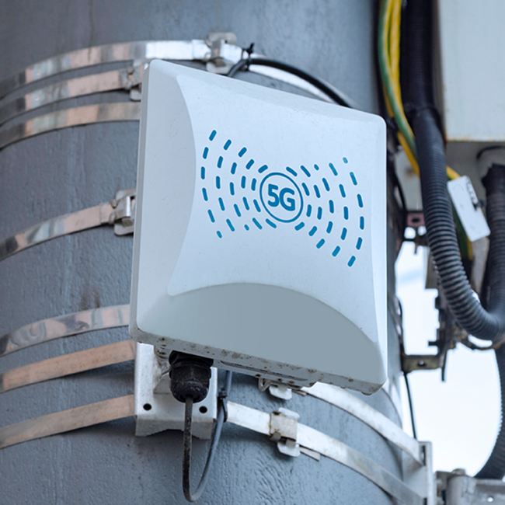
Small Cells in 5G
Small Cell Types
There are three types of small cells in the industry today:
Femtocells
Picocells
Microcells
Each type has its distinction based on its coverage capability and the number of individual users it can support.
Network cell planners and engineers sometimes consider femtocells in a separate class.

Slide 21
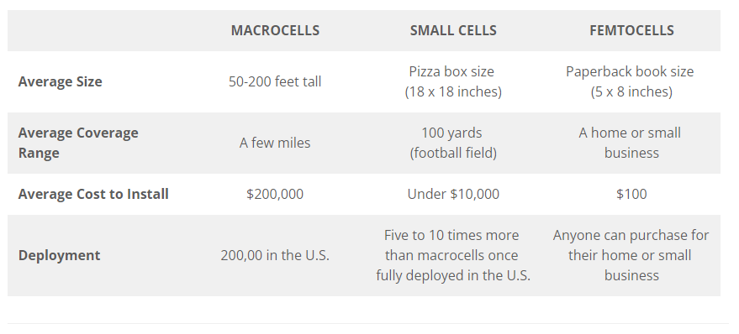
Small Cells in 5G
Macrocells vs. Small Cells vs. Femtocells

Slide 22
Small Cells in 5G
Small Cell Types
Femtocells
Femtocells are small mobile base stations that help extend coverage for residential and enterprise-level applications. These are mainly used to offload networks when they become congested. Femtocells can extend coverage and enhance building penetration for indoor consumers.
Femtocell Features:
Coverage area: 30-165 feet (10-50 meters) (indoor)
100 milliwatts
Supports 8-16 users
Backhaul: home or enterprise Ethernet
Low cost

Slide 23
Small Cells in 5G
Small Cell Types
2. Picocells
Another type of small cell technology, picocells are small cellular base stations that cover small indoor areas like buildings or aircraft.
Picocells are great for small enterprises to provide extended network coverage and large data throughput.
Applications include:
Offices
Hospitals
Shopping complexes
Schools and universities

Slide 24
Small Cells in 5G
Small Cell Types
2. Picocells
Picocell Features:
Coverage area (indoor): 330-820 feet (100-250 meters)
250 milliwatts
Supports 32-64 users
Backhaul: wired, fiber
Low cost

Slide 25
Small Cells in 5G
Small Cell Types
3. Microcells
The microcell is a cell in a mobile network served up by a low-power base station that covers limited areas, such as:
Malls
Hotels
Unique spaces within smart cities or transportation hubs
Microcells are generally more substantial than picocells, though the distinction is not always clear. Moreover, the microcell can support a more significant number of users in unique geographical areas.

Slide 26
Small Cells in 5G
Small Cell Types
3. Microcells
Microcell Features:
Coverage area: 1,600 feet-1.5 miles (500 meters-2.5 kilometers)
2-5 watts
200 simultaneous users
Backhaul: wired, fiber, microwave
Medium costs (more expensive than femtocells and picocells).

Slide 27

HetNets in 5G
Heterogenous Networks (HetNet) and their Role in 5G
The term HetNets, or heterogeneous networks, describes the inter-working of different radio network layers (the macro cell layer and one or more small cell layers).
HetNets increase network capacity by adding more cell sites; i.e., radio access networks, macro sites, in-building wireless and small cell deployments.
In short, HetNets use a combination of macro, pico, and femto cells to offer network densification.
HetNets appear as one ubiquitous, seamless network that incorporates different access technologies like 4G, 5G, and Wi-Fi.

Slide 28
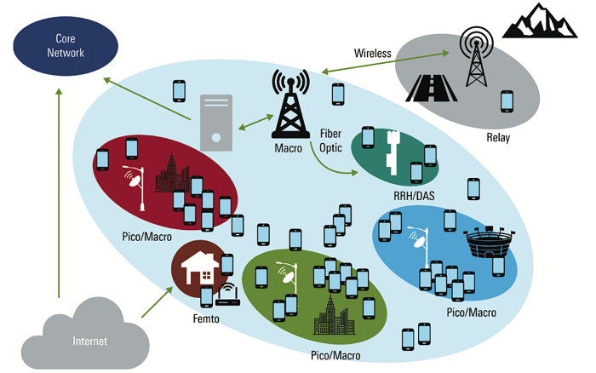
HetNets in 5G
Heterogenous Networks (HetNet) and their Role in 5G
HetNets significantly improve network coverage, they can also reduce power consumption and improve overall spectral efficiency.
HetNets offer relief and optimally benefit operators and users alike, but only if their installation is close to where additional capacity is required (i.e., close to the people) and a higher Signal-to-Interference-and-Noise-Ratio (SINR) can be achieved compared to the existing (macro-cell) deployment.
A high SINR results in high additional indoor capacity created by the new base stations.

Slide 29
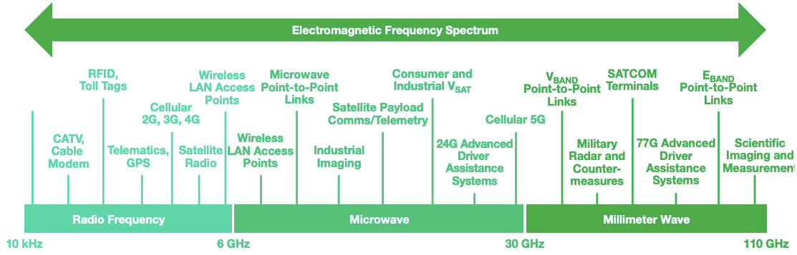

Millimeter wave Communication
Millimeter waves are also known as extremely high frequency (EHF).
It’s a radio frequency that would allow transmission frequencies between 30 GHz and 300 GHz, compared to 5 GHz frequencies used by previous mobile devices.
It also has wavelengths between 1 mm and 10 mm, compared to the several-dozen centimeter wavelengths possessed by smartphones’ current radio waves.

Slide 30
Millimeter wave Communication
Millimeter Wave Propagation
Millimeter wave signal propagation is characterized by:
High free space path loss
Significant atmospheric attenuation
Diffuse reflections
Limited penetration depth

Slide 31
Millimeter wave Communication
Millimeter Wave Propagation
1. High free space path loss
One limitation of millimeter wave radio frequency (RF) communication is the free space path loss (FSPL) for direct line-of-sight communication between two antennas.
The FSPL is inversely proportional to the square of the wavelength and is given by the following equation:
FSPL (dB) = (4πd / λ)²
where: d is the distance between the two antennas in m && λ is the wavelength in m.
As can be seen from equation, a 10X decrease in the wavelength results in a 100X increase in the free space path loss. Thus the attenuation at millimeter wavelengths is many orders of magnitude higher than the attenuation of more traditional communication frequencies like FM radio or Wi-Fi.

Slide 32
Millimeter wave Communication
Millimeter Wave Propagation
1. High free space path loss
In RF communication calculations, this loss equation is often converted to provide a result in dB, with the frequency measured in GHz and the distance measured in km. After this conversion, the equation becomes:
FSPL(dB)=20∗log10(d)+20∗log10(f)+92.45
A free calculator for evaluating the free space path loss is available here..

Slide 33
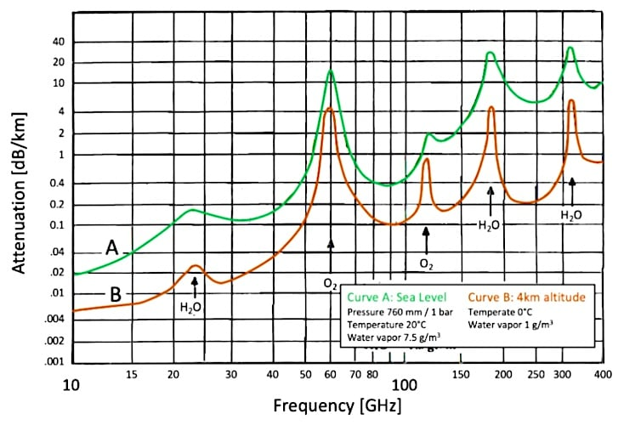
Millimeter wave Communication
Millimeter Wave Propagation
2. Significant atmospheric attenuation
Another drawback of millimeter wave transmission is the atmospheric attenuation.
In this range of wavelengths there is additional attenuation caused by the presence of atmospheric gases – primarily oxygen (O₂) and water vapor (H₂O) molecules.
As can be seen in Figure, the atmospheric attenuation can be very severe in certain bands...

Slide 34
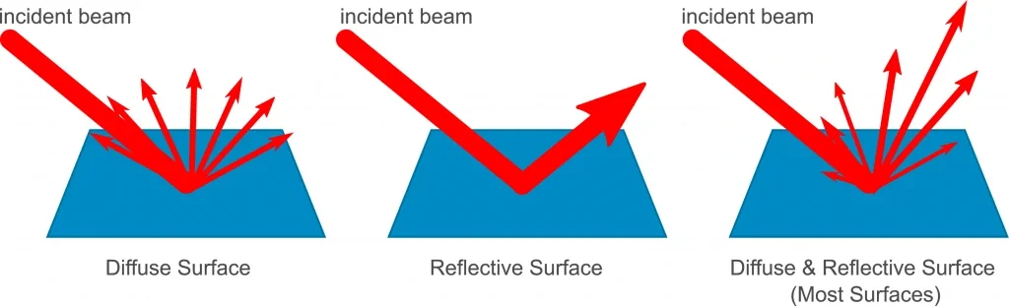
Millimeter wave Communication
Millimeter Wave Propagation
3. Diffuse Reflection
Longer wavelengths often rely on direct (specular) reflected power to assist in transmission around obstacles (think of mirror-like reflection).
However, many surfaces appear “rough” to millimeter waves, which results in diffuse reflections that send the energy in many different directions.

Slide 35
Millimeter wave Communication
Millimeter Wave Propagation
3. Diffuse Reflection
Thus, less reflected energy is likely to reach a receiving antenna.
Millimeter wave transmissions are therefore very susceptible to shadowing by obstacles and are typically limited to line-of-sight transmission..

Slide 36
Millimeter wave Communication
Millimeter Wave Propagation
4. Limited penetration depth
Because of their shorter wavelengths, millimeter waves do not penetrate deeply into or through most materials.
For example, a study of common building materials found that attenuation ranged from approximately 1 to 6 dB/cm and the penetration losses through a brick wall at 70 GHz may be five times higher than at 1 GHz.
Outdoors, foliage will also block most millimeter wavers.
Therefore, most millimeter wave communication is limited to line-of-sight operation...

Slide 37
!!THANK YOU!! !! Have a Nice Day!!
Today we learned about
Small Cells in 5G
HetNets in 5G
Millimeter wave Communication

